Slide 1
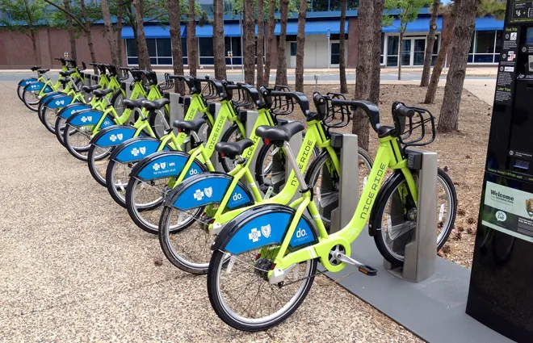
Bike Share Analysis

Slide 2
Bike Share Analysis
Summary for the month of February
Total Count of Trips | Total Stations Used | Total Bikes Used | Average Duration of Trip | Average Distance of Trip
183412 | 329 | 4646 | 704 sec | 1.7 Km

Slide 3
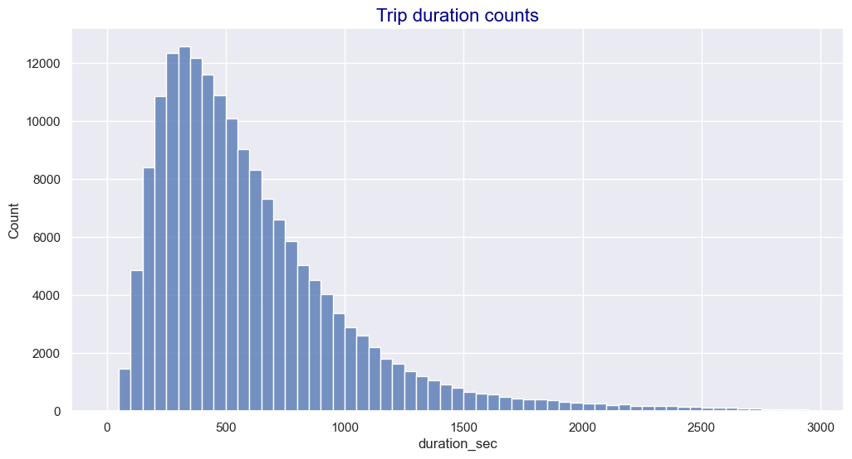
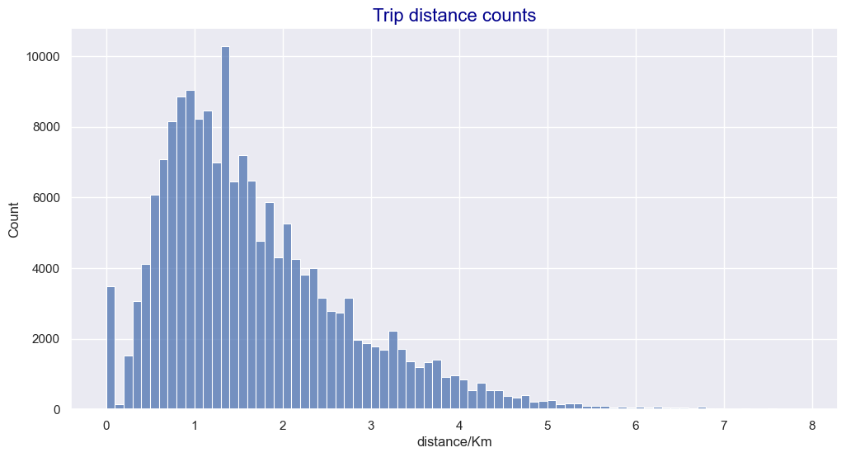
Trip Counts
80% of trips occurred at distances less than 2.5 km between stations with the peak number of trips occurring at around 1 km.
80% of trips occur at a duration less than 15 minutes. The peak number of trips occurs at a duration from 300 to 400 seconds (approximately 5.5 to 6.5 minutes).

Slide 4
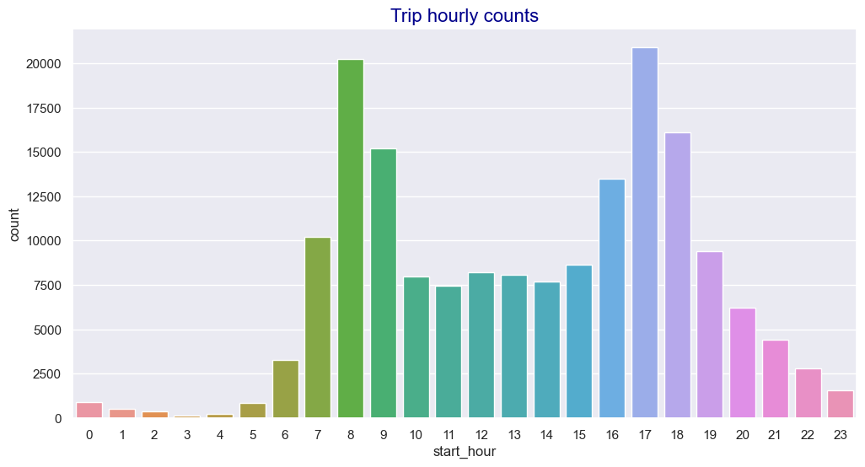
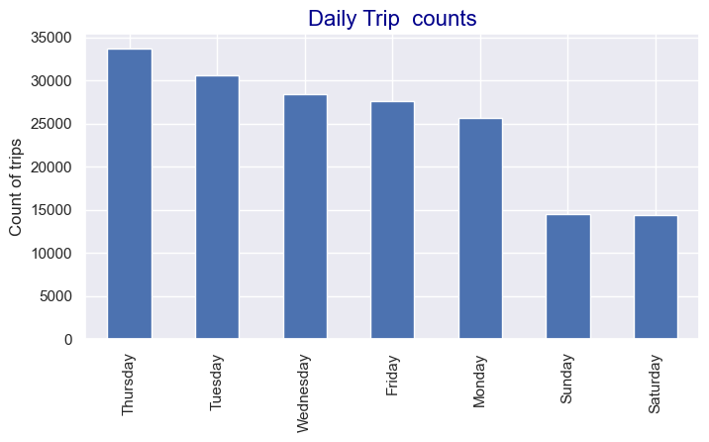
Trip Daily and Hourly Counts
- The average number of daily trips at weekdays is almost double the average daily trips at weekends.
- The peak hours at weekdays is at 8-9 AM and 5-6 PM. At weekends the peak time is at around 1-4 pm.

Slide 5
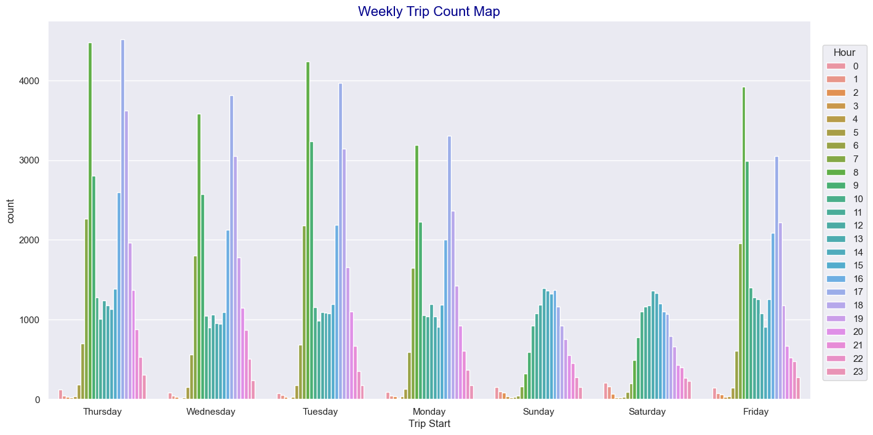

Slide 6
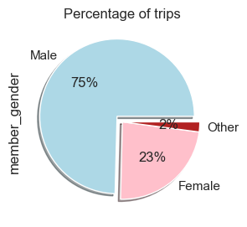
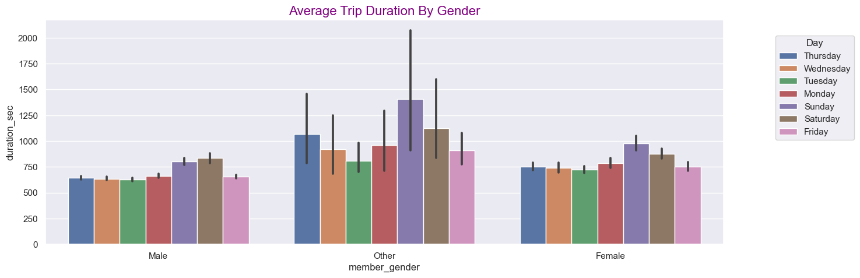
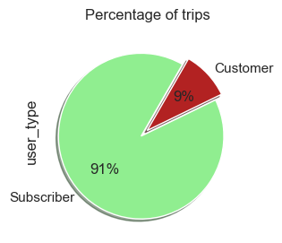
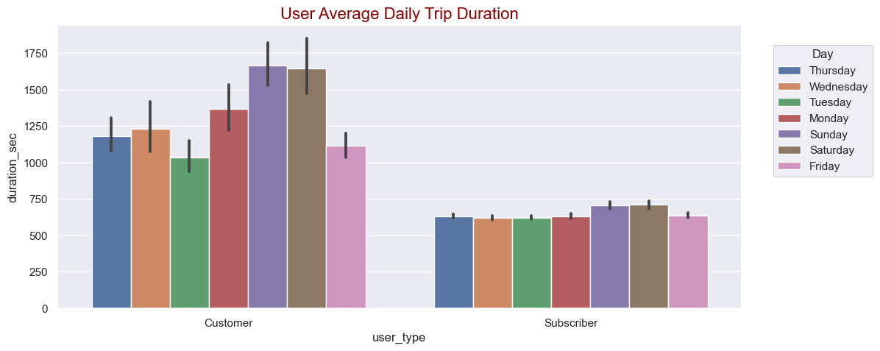
- 75% of the trips are males and 23% are females. However, males spend slightly less time and cover less distance on their trips than females and others.
- 91% of the trips are subscribers and customers are only 9%. Although customers use the bikeshare much less than subscribers, they do spend almost double the duration of the subscribers and they do cover slightly higher distance in their trips.

Slide 7
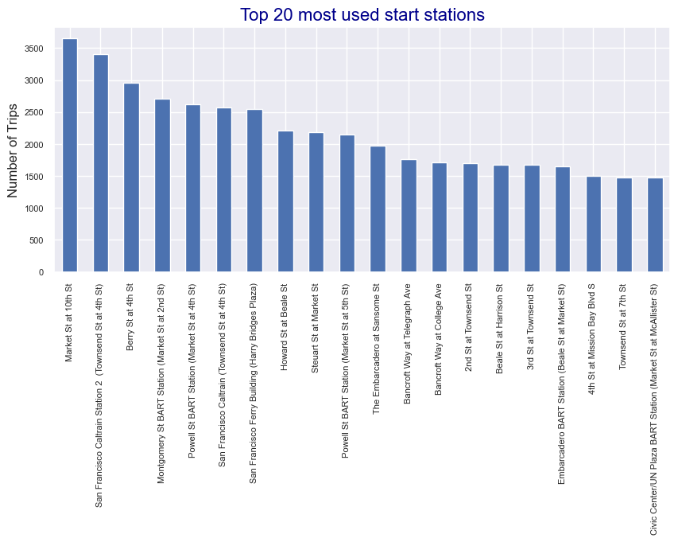
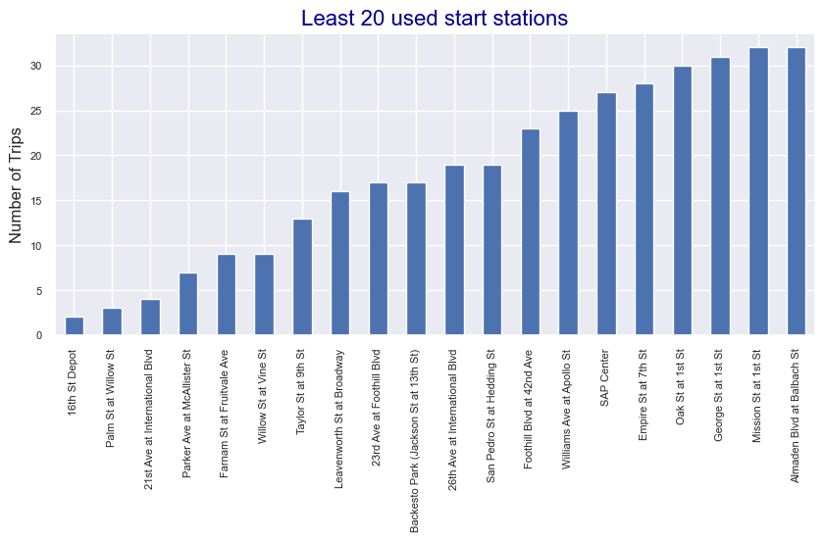
Stations
The most used 20 stations range from about 1600 to 3700 trips with an average of around 2200 trips per station.
-19 out of the top 20 used start stations are also in the top 20 used end stations and 19 out of the least 20 used start stations are also in the least 20 used end stations.
- The least used stations range from 2 to 32 trips with an average of 18 trips. There is so much difference in the number of trips between the most used stations and the least used stations.

Slide 8
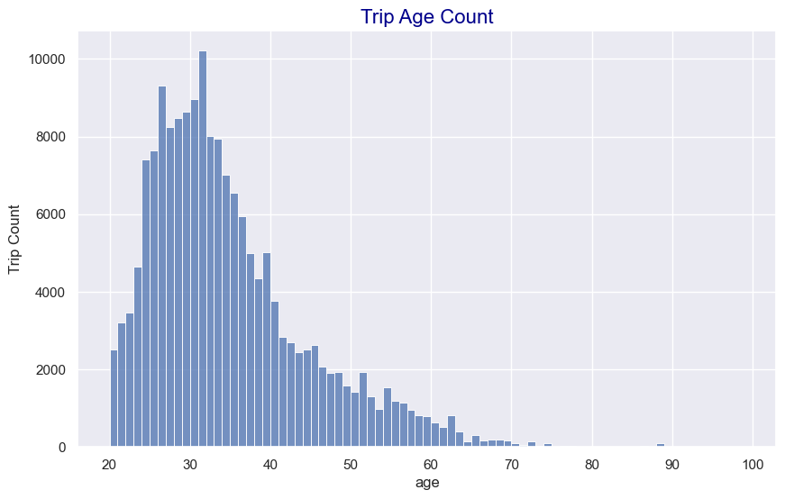
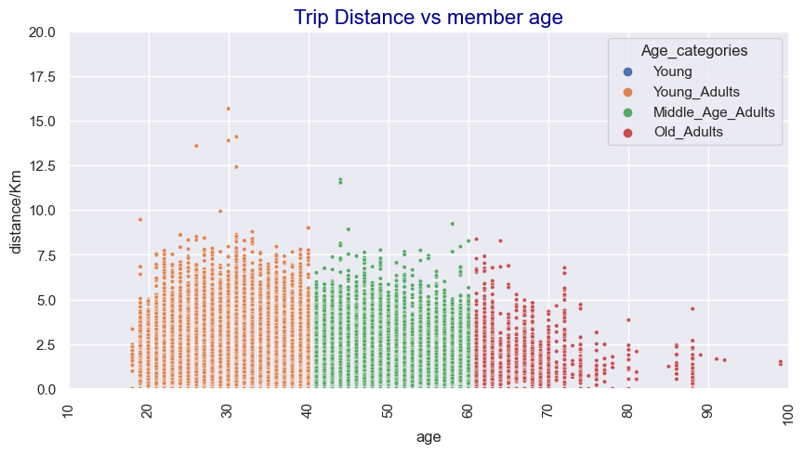
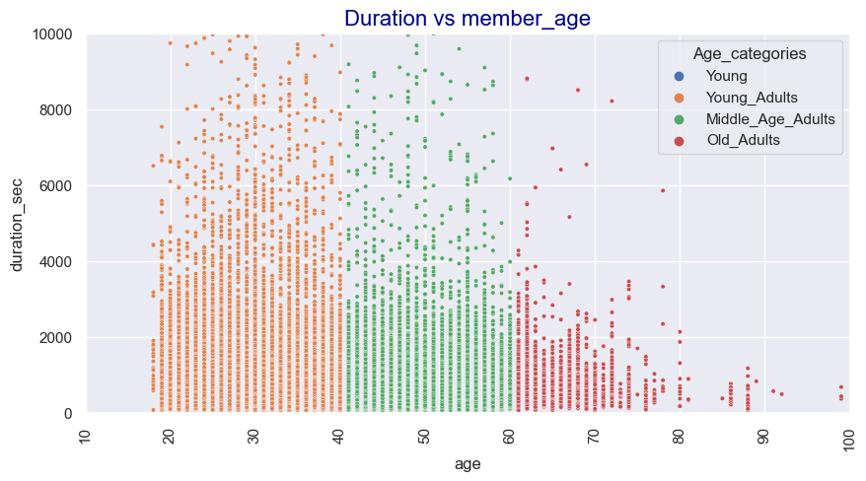
Age
80% of trips are by bikers less than 41 years of age. The peak age is around 30 years old.
- The number of trips with high distance and duration spent also dec

Slide 9
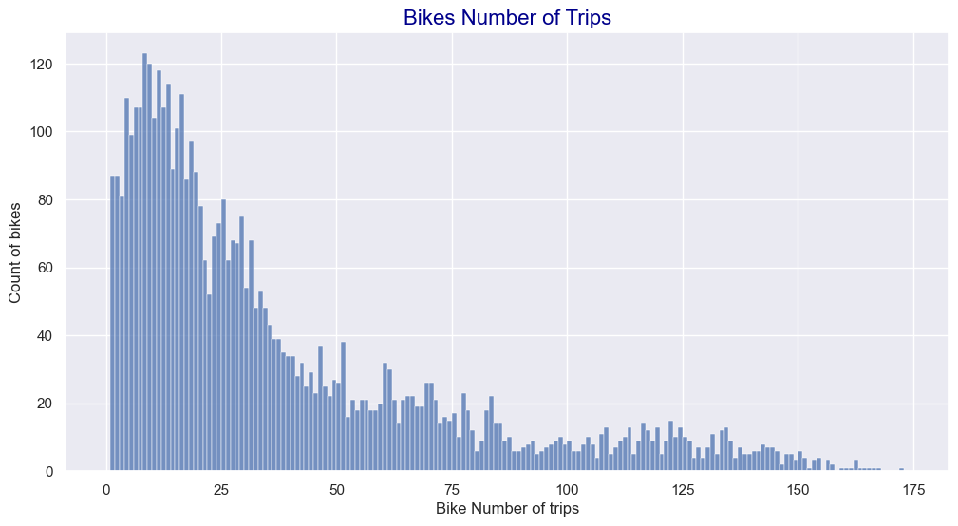
Bike Usage
- The majority of the bikes have less than 50 trips (almost 75% of the bikes) which shows that most of the bikes are not regularly used and there are a few number of bikes that are used repeatedly.

Slide 10
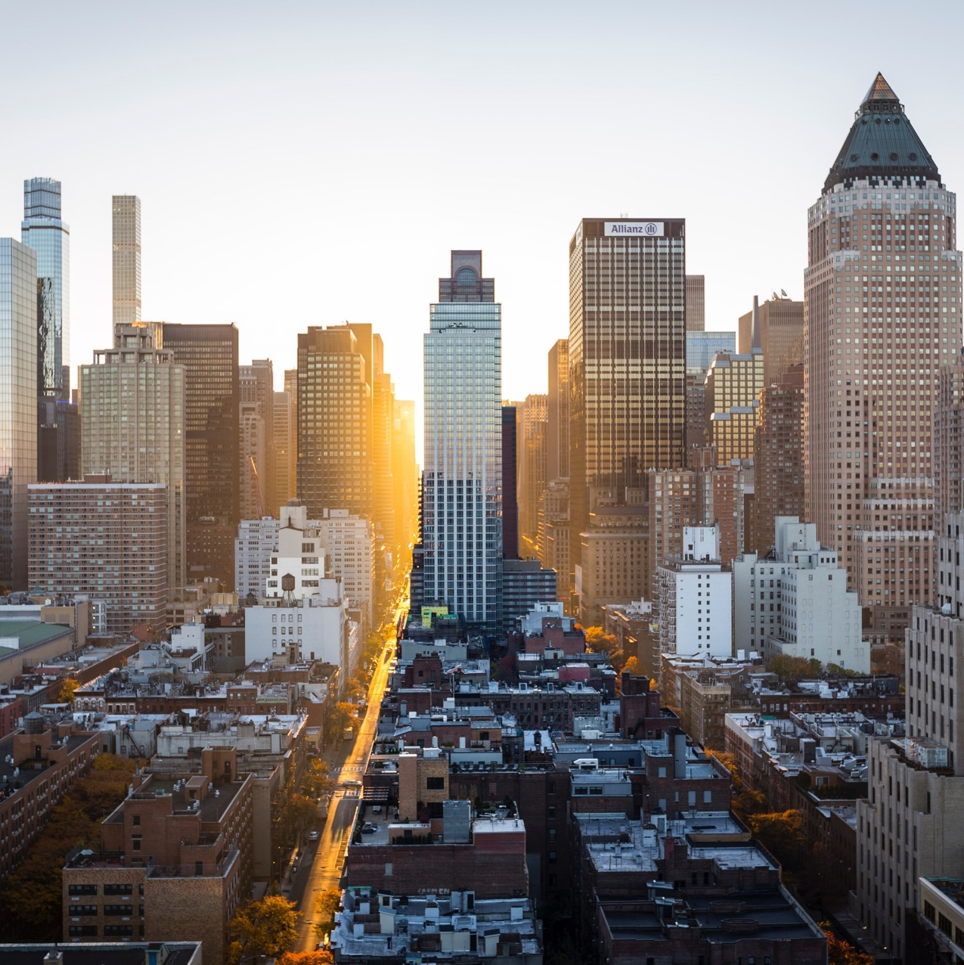
Thank you !

